Slide 1

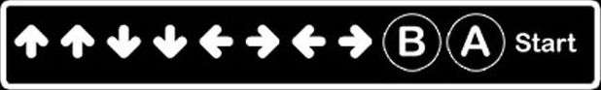


Home page hi-fi
username
Welcome
GTA V
Lego Marvel Superheroes
About us:
This is a paragraph about us and why we made this unnamed website
Lego Batman
Sims 4
Manage account
GDPR
Acceptable use
Privacy

Slide 2
Manage account page hi-fi
username
Account settings
GTA V
Lego Marvel Superheroes
email
example@gmail.com
change
username
user123
change
icon
change
Lego Batman
password
********
change
Phone number
07123456789
change
Sims 4
Manage account
GDPR
Acceptable use
Privacy

Slide 3

Game Page hi-fi
username
Lego Marvel Superheroes
GTA V
Lego Marvel Superheroes
Cheat codes:
Lego Batman
Cheatcode1
Cheatcode2
Cheatcode3
cheatcode4
Sims 4
Manage account
GDPR
Acceptable use
Privacy

Slide 4

Login/Signup page hi-fi
Login
Enter Username
Enter Password
Forgot Password?
Login now
Don’t have an account? Sign up
GDPR
Acceptable use
Privacy

